Slide 1
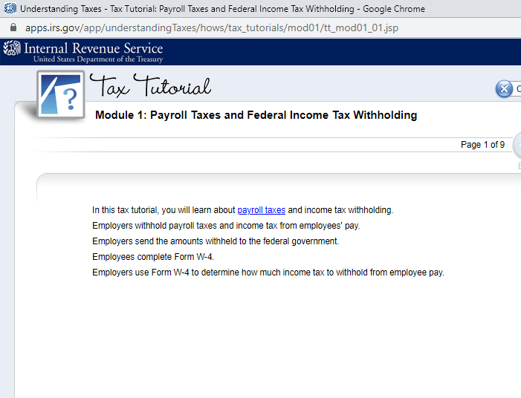

Slide 2

Payroll Taxes
Enter starting Page 3 under Define Payroll Taxes
Payroll Taxes Defined: A withholding tax is an income tax that an employer remits on behalf of an employee to the government for taxes. Withholding tax are also known as Payroll taxes or Pay as You Earn. Payroll Taxes that might come out of your paycheck are as follows:

Slide 3
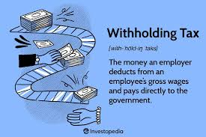
Five Types of Taxes
Federal Income Tax
Social Security Tax
Medicare Tax
State Income Tax
Local Income Tax

Slide 4

Five Types of Taxes and their Definition: (on bottom of page 3).
Federal income tax. This is income tax your employer withholds from your pay and sends to the IRS on your behalf. Amount withheld largely depends on what you put on your W-4.
2. Social Security tax: 6.2%. This tax typically is withheld on the first $142,800 in 2021. Paying this tax is how you earn credits for Social Security benefits later.
3. Medicare tax: 1.45% Sometimes referred to as the “hospital insurance tax,” a federal health insurance program that gives millions of people 65 and older and certain disabled individuals access to medical treatment.
Note: Social Security and Medicare Taxes are also Called FICA Taxes: These taxes are payroll taxes allowed by the FICA Act that are given back to you when you retired at the age of 62 or older
4. State tax: This is state income tax withheld from your pay and sent to the state by your employer on your behalf. The amount depends on where you work, where you live and other factors
5. Local income or wage tax: Your city or county may also have an income tax. This money might go toward such expenses as the bus system or emergency services in your local city

Slide 5
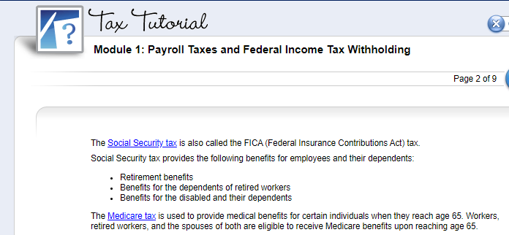
Top of Page 4 in table - % on next slide
Benefits:
hospital insurance
medical insurance
Medicare Advantage plans
Prescription drug coverage

Slide 6
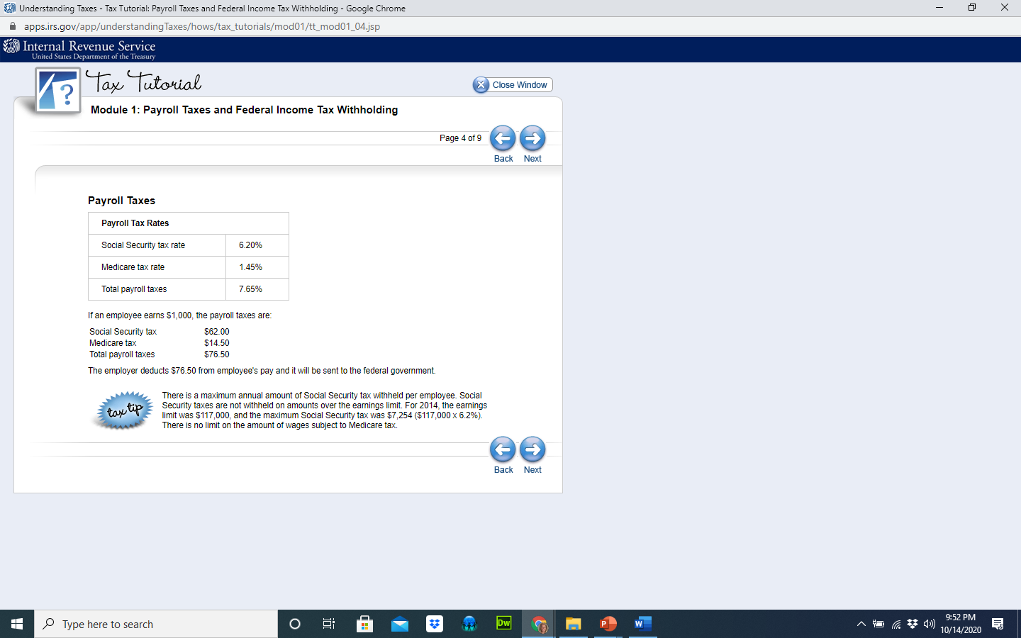
Employee % Withheld for FICA Taxes
Every Paycheck you earn, you will pay FICA taxes on your gross wage at 6.2% for Social Security, and 1.45% for Medicare Taxes as depicted below:
$1000 X .062 = $62.00
$1000 X .0145 = $14.50

Slide 7
EMPLOYER % Paid for FICA Taxes
Every Paycheck your Employer must MATCH what you paid in FICA Tax. So employers will also pay 6.2% for Social Security, and 1.45% for Medicare Taxes as depicted below:
What EMPLOYEE Pay to FICA
What EMPLOYER Pays to FICA in Your Name

Slide 8
Amount Paid To the Government by Employer in Your Name
Your contribution: $76.50
Employer contribution: $76.50
Total Contribution: $153.00
If you are self employed – you pay both the employee contribution and the employer contribution as you are the employee and the employer.
In Your packet, you do the math. If you earned $1500 for the past two weeks, how much is our Social Security Tax you pay. How much does the employer also pay?

Slide 9
Assignment:
In Your packet, middle of page 4, complete the chart shown below
If you earned $1500 for the past two weeks, how much is our Social Security Tax you pay. Complete the information below. How much does the employer also pay?
Example: If you earned gross wage of $1500 for two weeks. What are the following:
Employee Contribution Social Security: Employer:
Employee Contribution Medicare: Employer:
Total Employee Contribution to Payroll Taxes: Total Employer:
What is the total amount sent to the government in your name for FICA Tax?
If you are self employed – you pay both the employee contribution and the employer contribution as you are the employee and the employer.

Slide 10
Other Withholding from your Gross Wage
In addition to the mandatory withholdings (taxes) that an employer makes for taxes and court orders, voluntary withholding amounts that employers may be willing to withhold at the direction of its employees include:
401(K) and 403(b) contributions
Insurance premiums
U.S. Savings bonds purchases
Union dues
Charitable donations
Payments owed to the company for the purchase of company merchandise

Slide 11
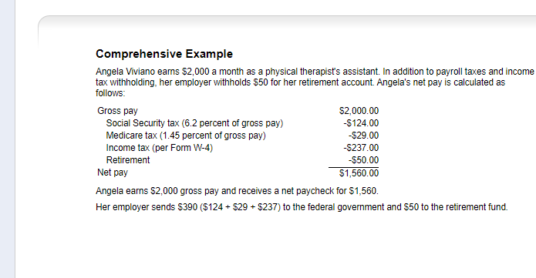
On bottom of Page 4: Calculate the following Net Wage: You work for $2000 gross pay for the two-week period. Your federal income tax is $225 and you have $100 withheld and put into a 401 K. There is no state or local tax where you live. What is your net income after you calculate the FICA taxes?
In Your packet, complete the bottom of page four similar to what is shown above. Use the totals in the packet, and calculate your Social security and FICA taxes. What is your net pay?

